Slide 1

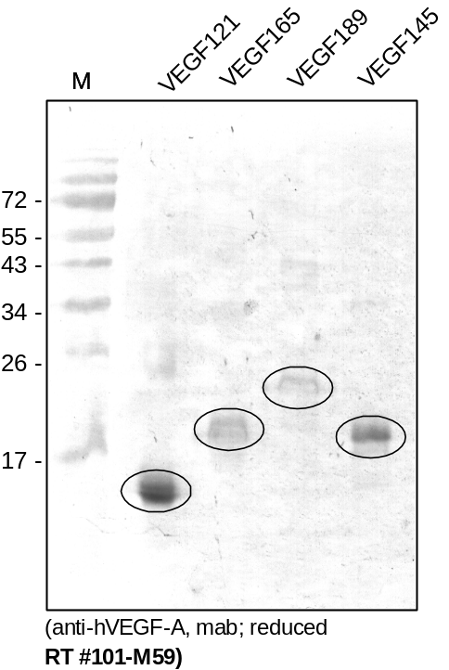
ReliaTech GmbH
Anti-human VEGF-A
(Cat #101-M59)
Figure 1. Western analysis of recombinant human VEGF-A isoforms using a monoclonal mouse anti-human VEGF-A antibody [Cat# 101-M59].
http://www.reliatech.de / orders@reliatech.de

